Slide 1

Guide Dog
Shared vision pipeline for the euROBIN VIP demo

Slide 2
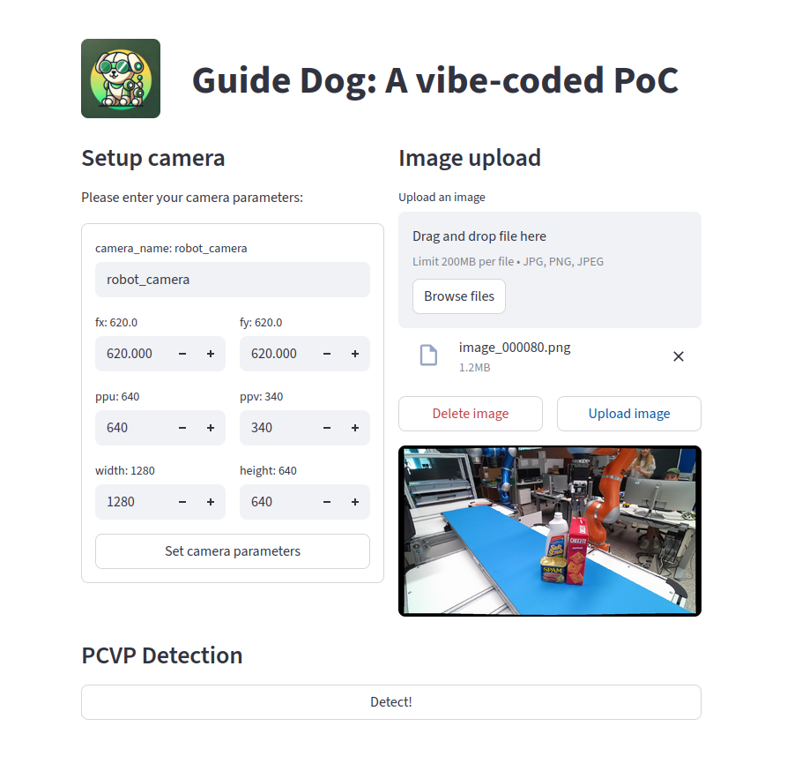
Motivation
Guide Dog to the rescue!
Robot use case
User: “We have a camera on our robotic system but no object pose estimation”
User sends image to obtain full 6D pose for all visible objects
Registration for user requests from outside the institute and authentication
Prototyping use case
User: “I have a camera and just need quickly the 6D pose of this object for some tests”
Potentially requested from within the institute

Slide 3
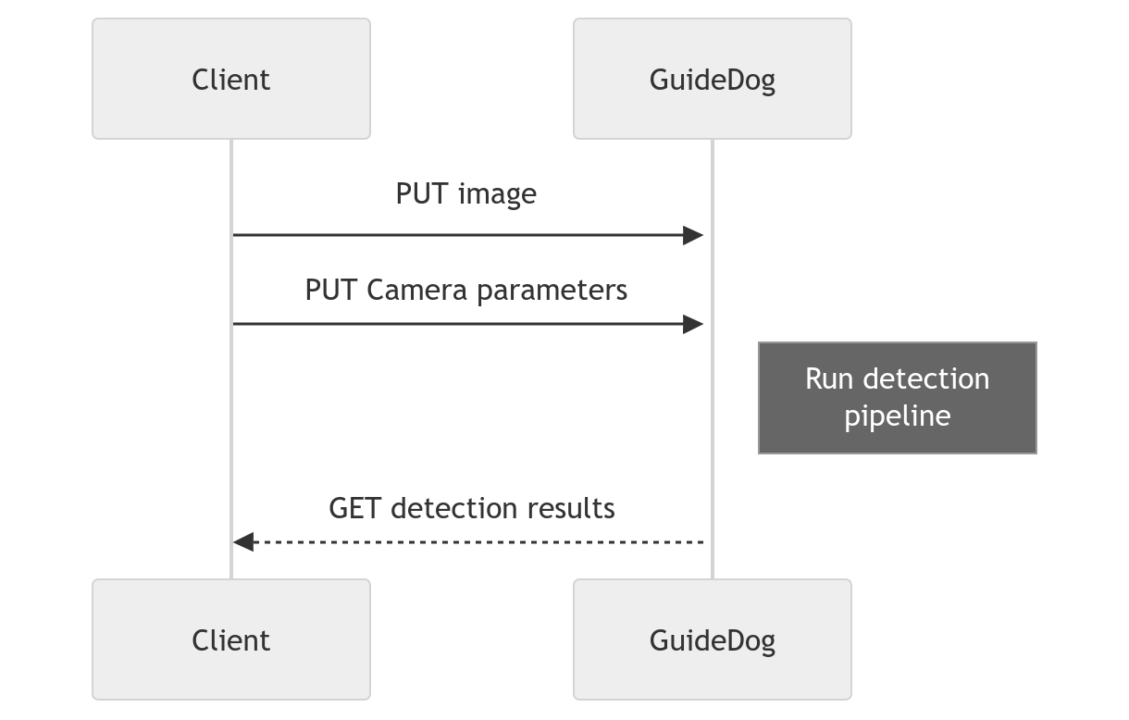

Current API definition
Pipeline Setup
Model-based 6D pose estimation
Agree on limited set of objects beforehand
Fine-tune on real data

Slide 4
Open Questions
How to provide access?
Webserver
More preparation time from DLR, but hopefully accessible before September
Internet access is not guaranteed in EU parliament
Offline Computer in local network
Setup during the preparation week in Brussels
Speed: We need to profile inference and network delays
Precision: Collect data to fine-tune weights
Performance?

